Slide 1
41183 PRIVACY PRESERVING
Lecture 1. Subject overview

Slide 2
Teaching Team
Subject coordinator, lecturer:
Prof Shui Yu: shui.yu@uts.edu.au
Tutors:
Ms Wanyu Li: Wanyu.Li@student.uts.edu.au ，
Mr Xiaoyu Ding: Xiaoyu.Ding@student.uts.edu.au ,
Mr Luoyu Chen: Luoyu.chen@student.uts.edu.au,
Mr Mingjian Tang: Mingjian.Tang@uts.edu.au .

Slide 3
Lectures (online)
Canvas Zoom (Monday, 13:00-13:50)
Join on your computer, mobile app or other device
We will record the lectures or pre-recording.

Slide 4
Lab sessions
Labs (Week 2-week 12, on campus), compulsory.
Python based

Slide 5
Assessment
Two assignments
- A1: Report on privacy attacks, group work, due on week 7, 50 marks.
- A2: Privacy preserving project, individual work, due on week 12, 50 marks.
No exam for this subject

Slide 6
aims of the subject
Present the landscape of digital privacy with the latest developments and applications.
Introduce the solutions for privacy preserving.
Training the capability of problem identification, and methodologies for searching solutions.

Slide 7
What is privacy
Privacy matters
“Privacy enables us to create boundaries and protect ourselves from unwarranted interference in our lives, allowing us to negotiate who we are and how we want to interact with the world around us.”
Privacy is human rights
“Privacy is a fundamental human right. The right to privacy is articulated in all of the major international and regional human rights instruments. Over 130 countries have constitutional statements regarding the protection of privacy.”
https://eachother.org.uk/the-right-to-privacy-and-why-it-matters/

Slide 8
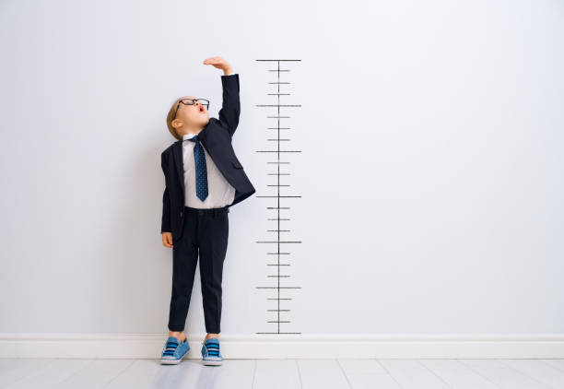
What is privacy
Privacy definition and measurement
- k-anonymity.
- information theoretical measures
Information leakage
Entropy variation
Social distance
NO direct measure

Slide 9
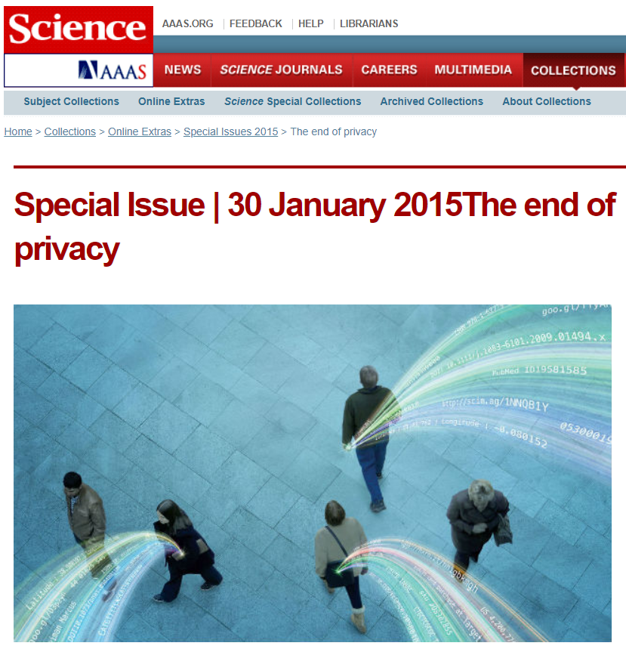
What is digital privacy
Digital privacy started to booming after 2000
Big data, big problem (Science, 2014)
The end of privacy in big data era (Science, 2015 January)

Slide 10
What is digital privacy
AI brings a significant concern on Privacy
Large Language Model
Privacy for trading
…

Slide 11
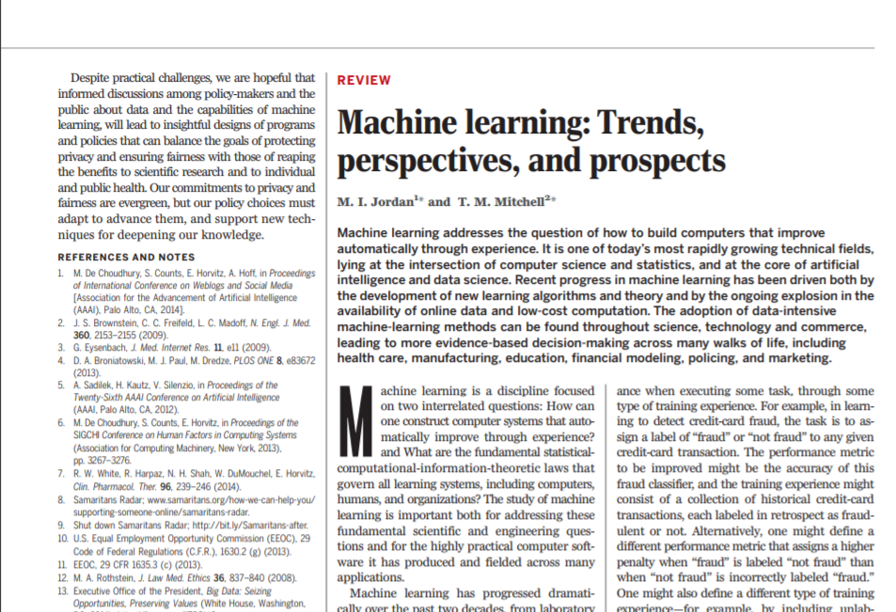
What is digital privacy
Data Mining community- privacy aware mining
Social science community – policy, psychology, etc.…
M. Jordan and T. Mitchell,
“Machine learning: trends, perspectives, and prospects,” Science, vol. 349, no. 6245, pp. 255–260, 2015.

Slide 12
Difference between privacy and security
Background difference
- security: know the secret or none (1 or 0)
- privacy: know partial of the secret
Setting difference
- security: against opponents
- privacy: face public

Slide 13
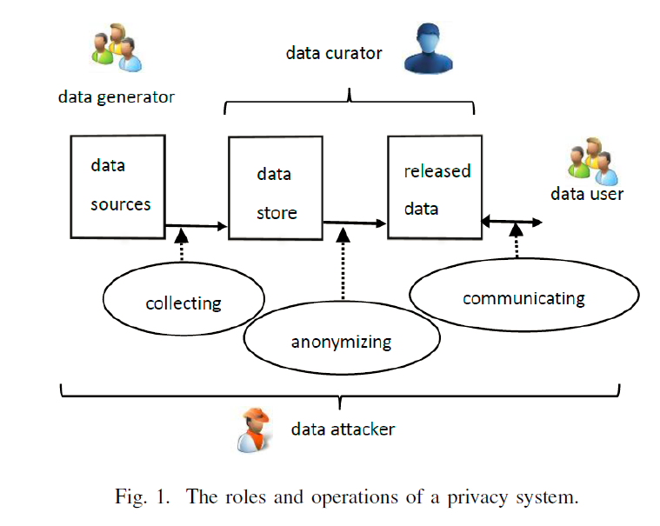
Digital privacy
Shui Yu, “Big Privacy: Challenges and Opportunities in Privacy Study in the Age of Big Data,” IEEE Access, no. 4, 2016, pp. 2751-2763.

Slide 14

Digital Privacy: an Introduction
Essential problem of digital privacy
Data utility for public
Privacy protection of data generators
Goal
A trade-off between the two perspectives for a given case.
Shui Yu, “Big Privacy: Challenges and Opportunities in Privacy Study in the Age of Big Data,” IEEE Access, no. 4, 2016, pp. 2751-2763.

Slide 15
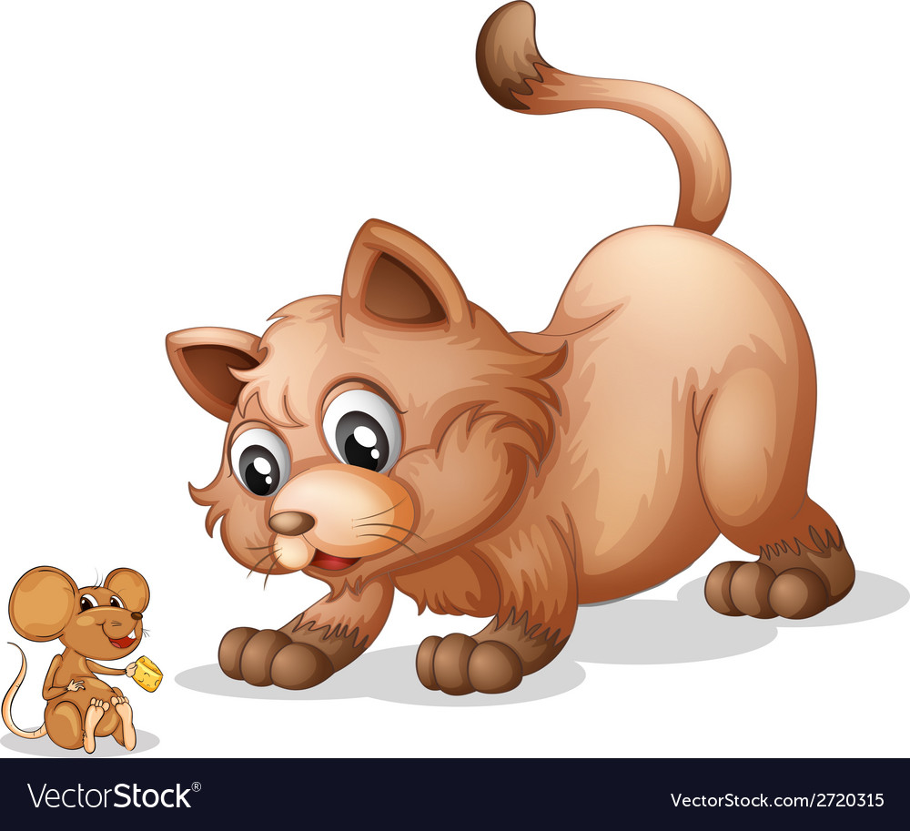
Digital Privacy: an Introduction
AI and privacy- natural enemies
AI: recommendation is based on personal information
AI needs your sensitive and personal information

Slide 16
A curator may not be trustworthy
October 2016, sensitive personal information of 550,000 customers of the Australian Red Cross Blood Service was exposed online through human error.
Qantas (2025): A cyberattack compromised the personal data of 5.7 million customers, including names, emails, phone numbers, and frequent flyer details. The breach originated from a third-party platform and has led to widespread scam attempts.
Australian National University (ANU): Previously targeted in a sophisticated attack that exposed sensitive student and staff data, demonstrating that even highly secure institutions are vulnerable
Medibank …
…

Slide 17
Roadmap of the subject
Overview of privacy preserving
Access control, encryption, and LLM for privacy
Anonymization and K-anonymity
Differential privacy I
Differential privacy II
Personalized privacy
Web browsing privacy
Deepfake attack and countermeasures
Federated learning and secure data aggregation
Poisoning attack and counter measures
Machine unlearning
Subject review

Slide 18
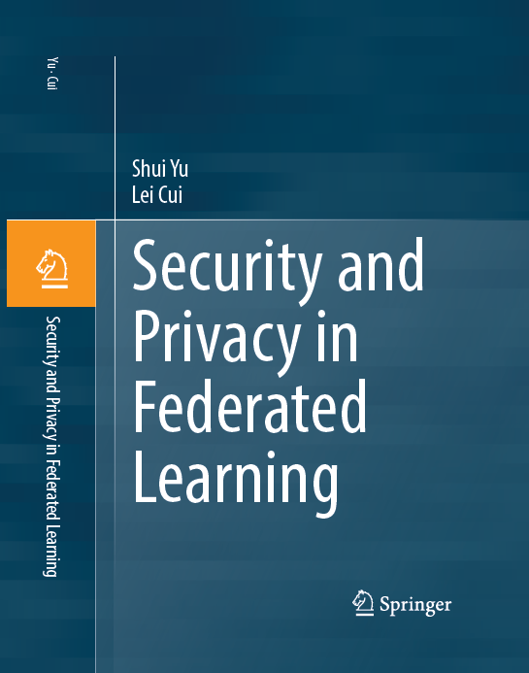
References
Other material will be
available at Canvas
Available at UTS library

Slide 19
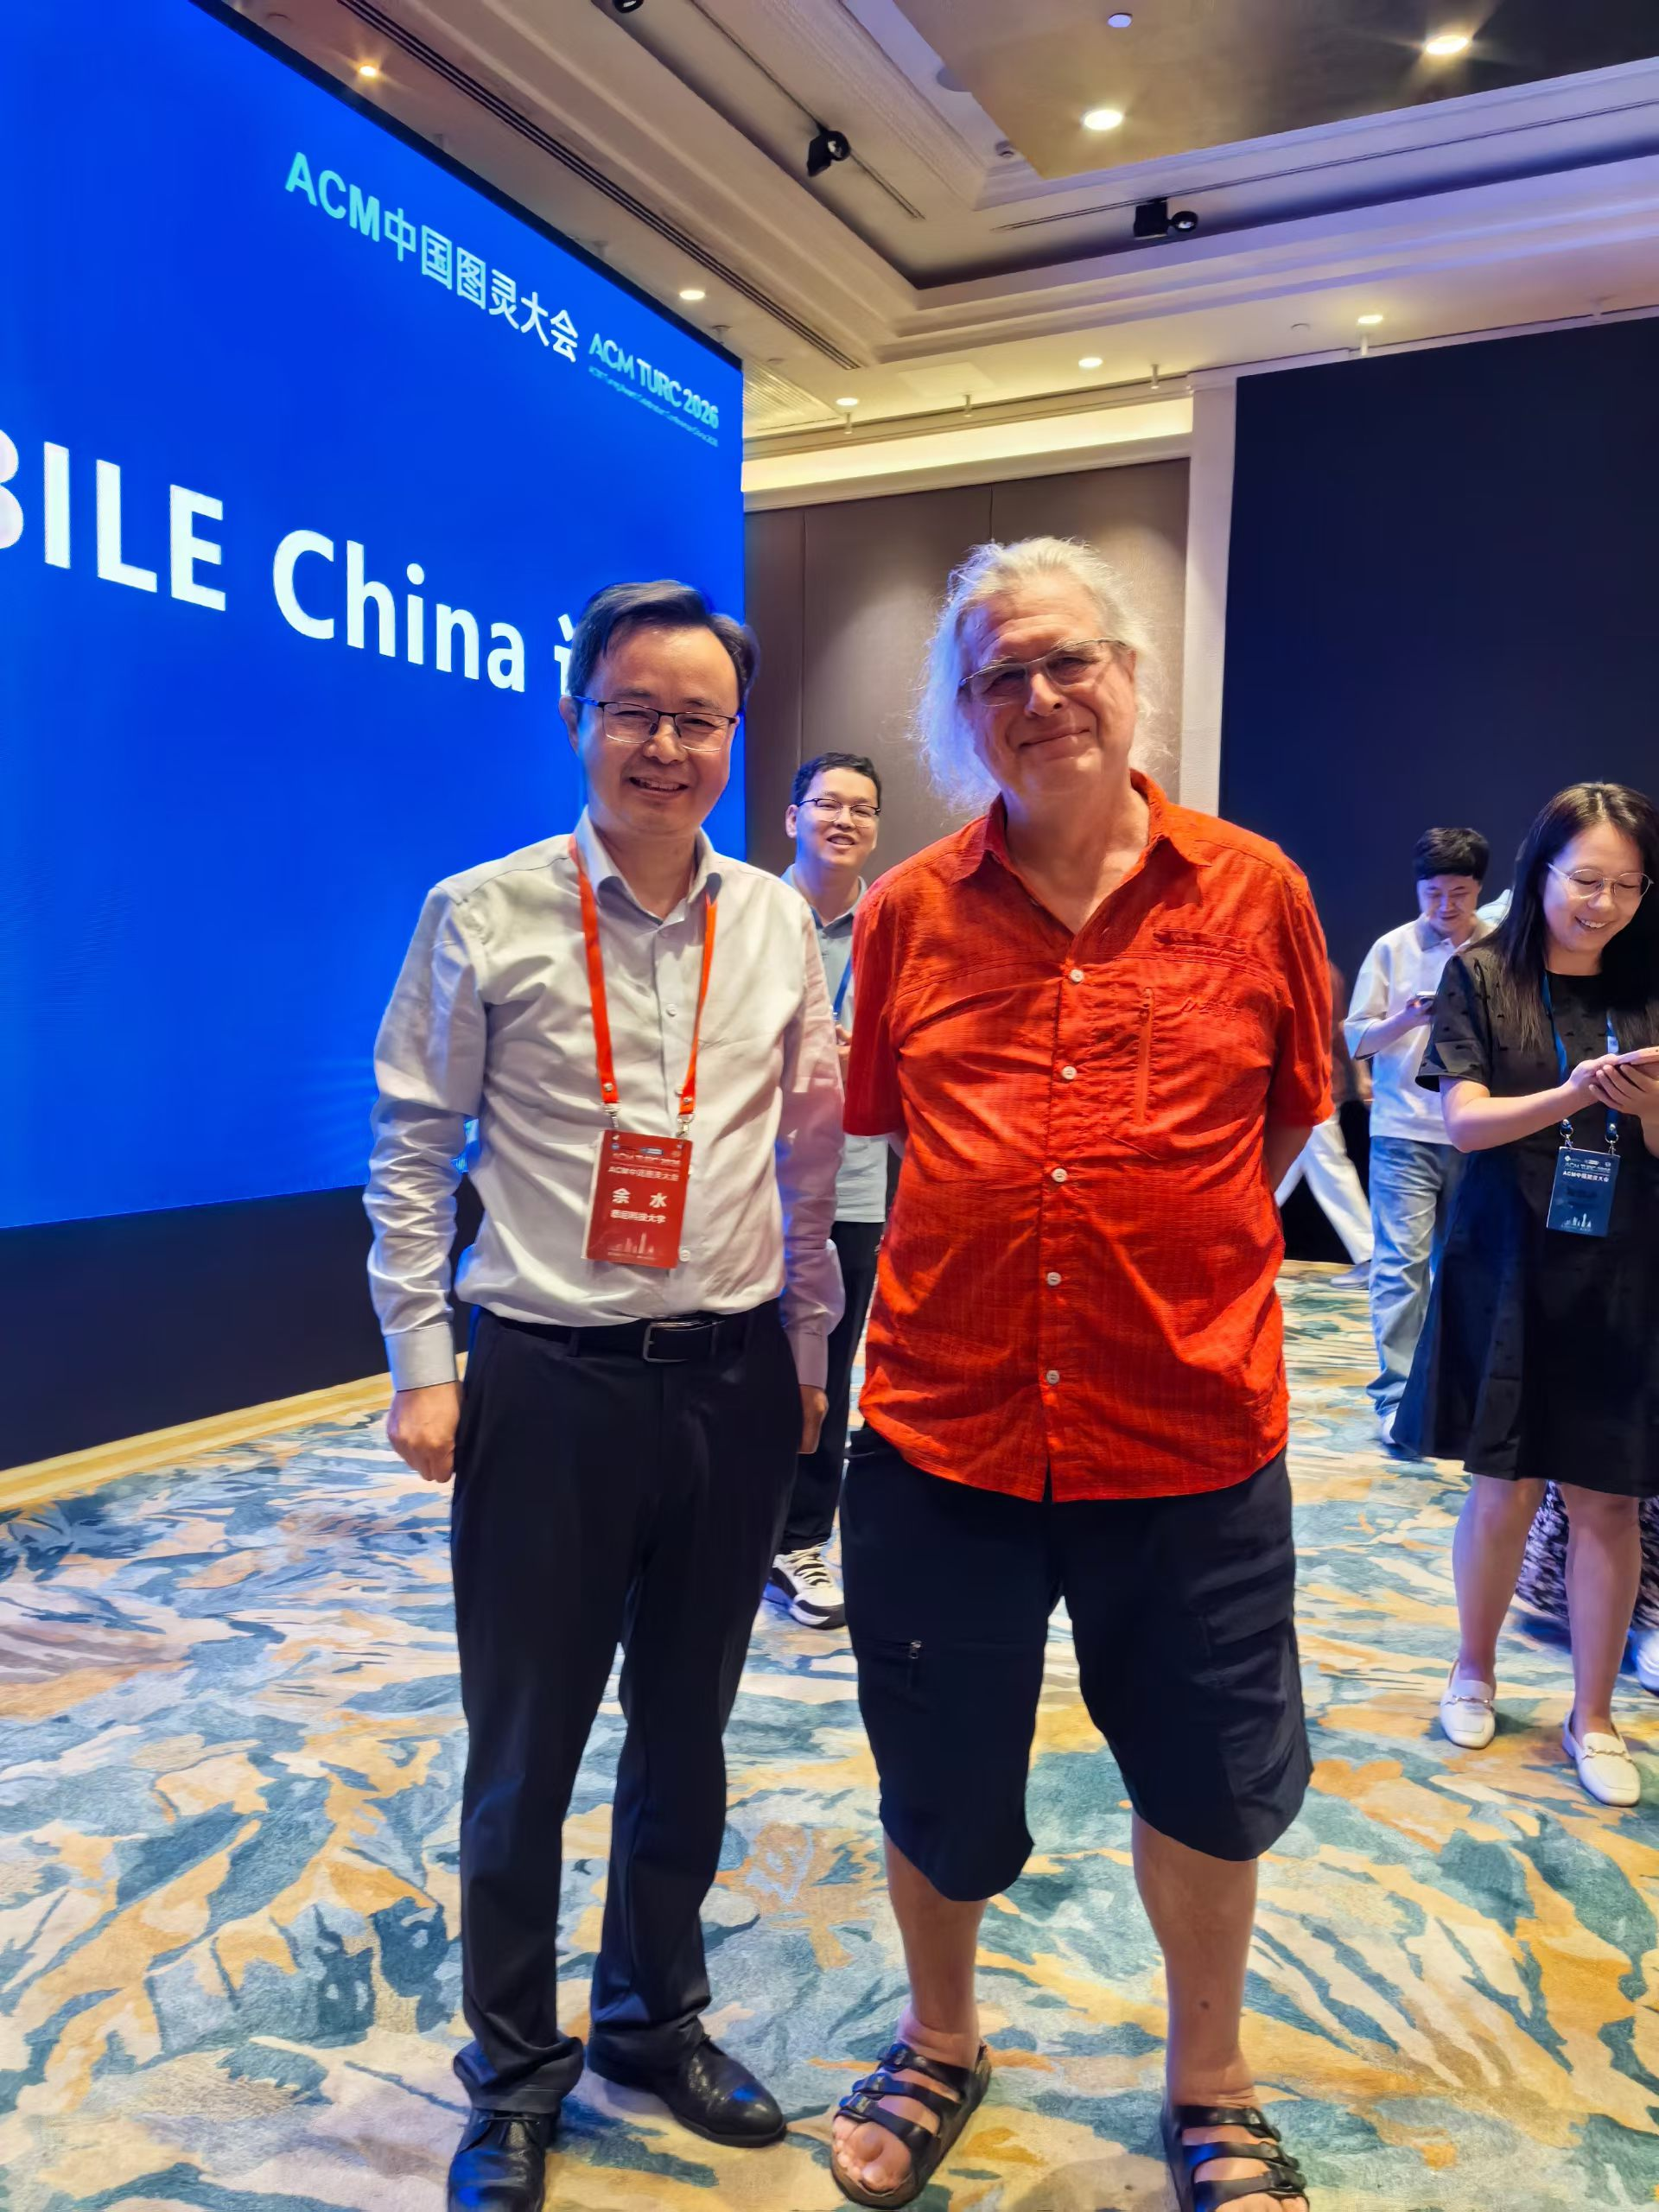
New directions of privacy protection
Cross disciplinary study
- Privacy + psychology
- Privacy + economics
- Blind Computing
- …
https://en.wikipedia.org/wiki/Gilles_Brassard

Slide 20

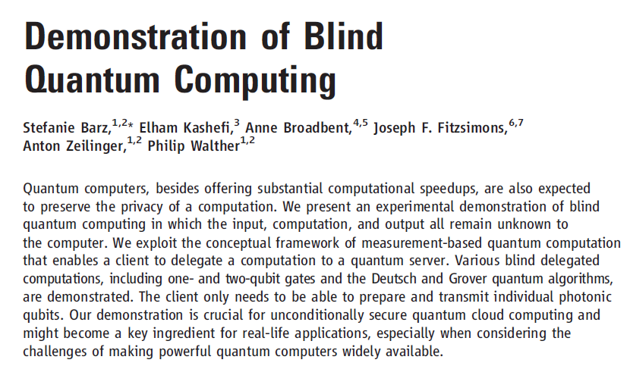
Is (Unconditional) Blind Computing Possible ?
Science, 20 Jan 2012 Vol 335, Issue 6066

Slide 21

Thank you & Questions http://www.uts.edu.au/syu email: shui.yu@uts.edu.au

